Slide 1






CSE323.3
FIRE DETECTION
SYSTEM USING ARDUINO
Presented by Team Tech ZRSP
Md Sadikur Rahman Sadeed 2112251642
Ahmed Zulkar Nayeen 2121592642
Nurjahan Bint Hamid 2212396042
Nusrat Jahan Rima 2122210642

Slide 2






TECH ZRSP
01
PROJECT
SUMMARY
Detects fire using a flame sensor.
Alerts via light
Provides real-time monitoring using Arduino and ESP8266.
LANGUAGES &
C++ FOR ARDUINO CODE
TOOLS USED

Slide 3


OBJECTIVE
Develop a simple, cost-effective fire detection system.
Ensure timely notifications for safety.
Explore and learn:
Arduino circuit building.
Integration of hardware and software.
PROJECT GOAL
02

Slide 4



TECH ZRSP
IMPLEMENTATION OVERVIEW
Designed and built a flame detection circuit.
Configured ESP8266 as a wireless TCP server.
Developed backend to:
Trigger alarms.
Created a circuit diagram using Circ Designer.
03

Slide 5

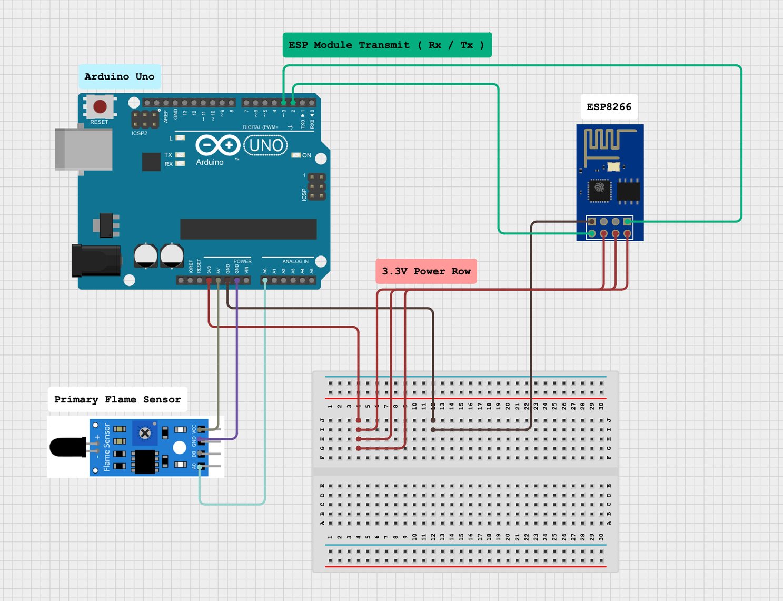
04
COMPONENTS
LIST
Arduino Uno
Flame Sensor Module
ESP8266 ESP-01 Module
Breadboard, jumper wires, etc.
Visual Studio Code with PlatformIO.

Slide 6

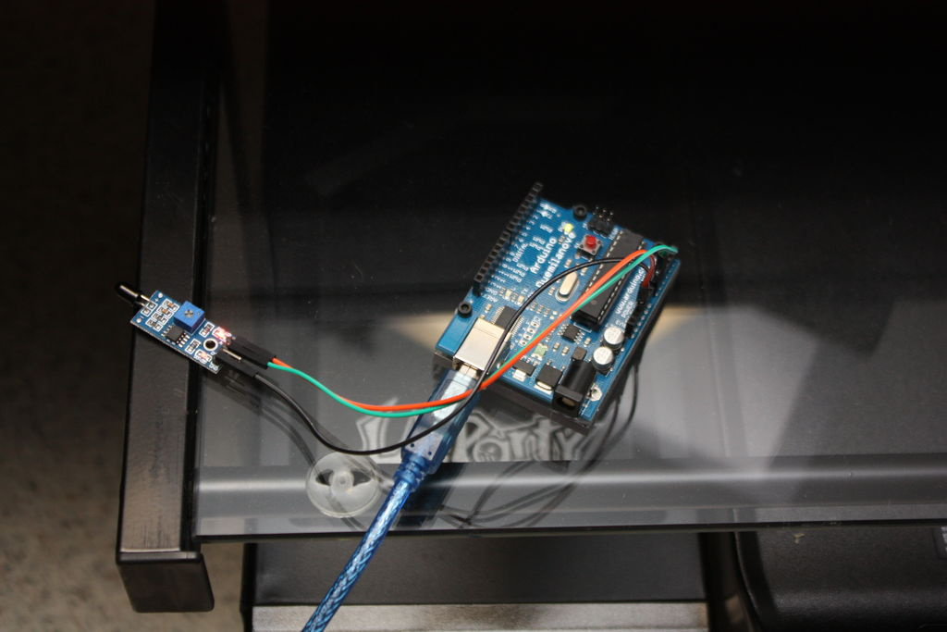
TECH ZRSP
05
CHALLENGES WE FACED
Setting up the ESP8266 module as a TCP server.
Fine-tuning sensor accuracy to minimize false alarms.
Managing power and connectivity issues in testing.
Thank You

